Slide 1


Charge Injection System (CIS) Update
Dawit Belayneh, Katie Hughes
The University of Chicago
August 30, 2021

Slide 2
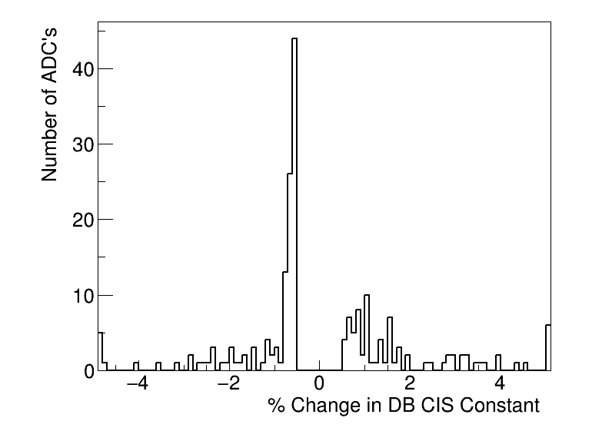
Summary
Updated on Aug. 23
CIS runs from July 2 - Aug. 20
178 channels in the update
11 > 5% change

Slide 3
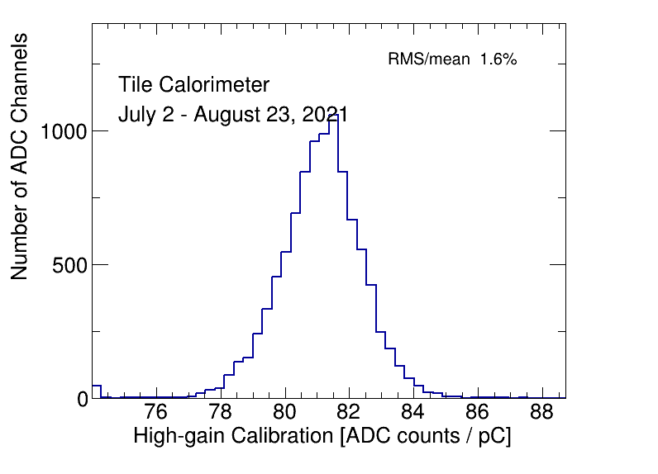
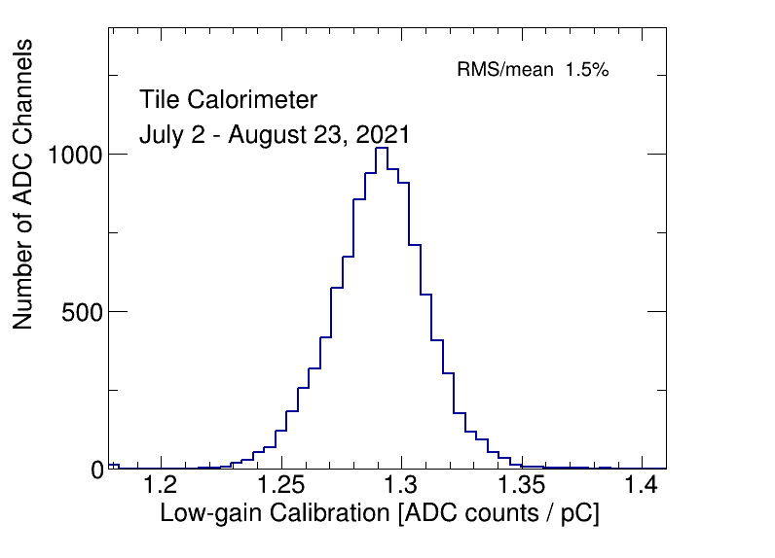
CIS constant distributions

Slide 4
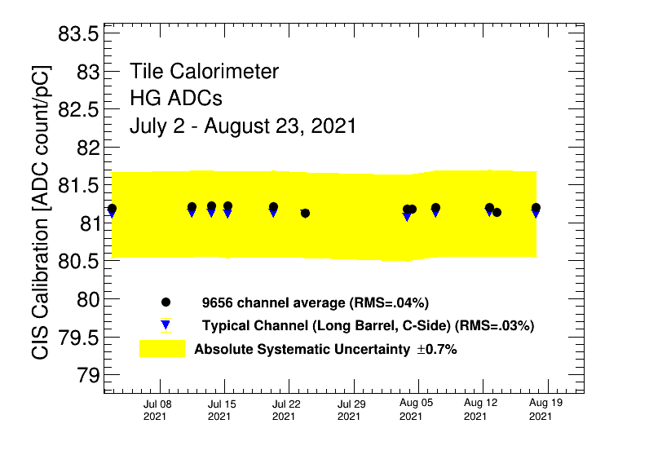
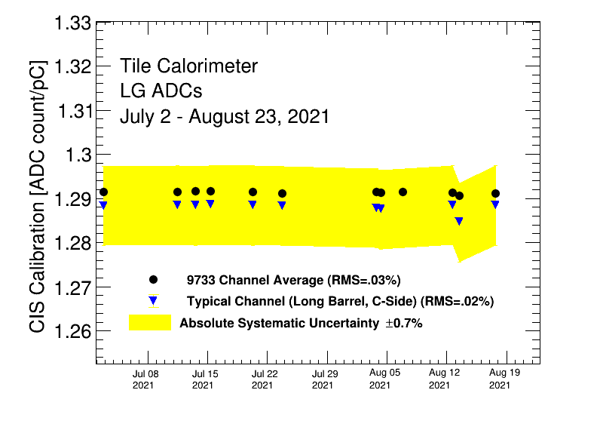
Detector stability

Slide 5
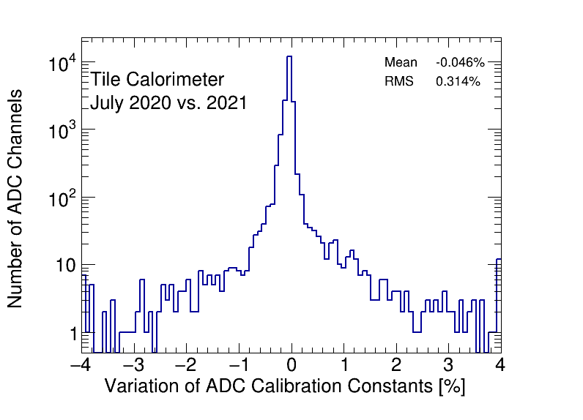
CIS constant stability

Slide 6
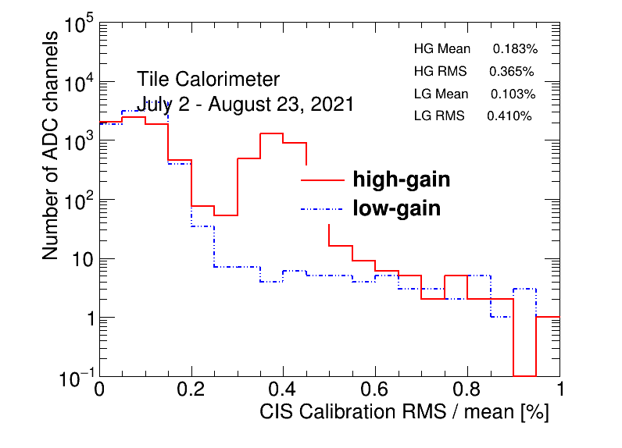
CIS constant RMS/mean

Slide 7
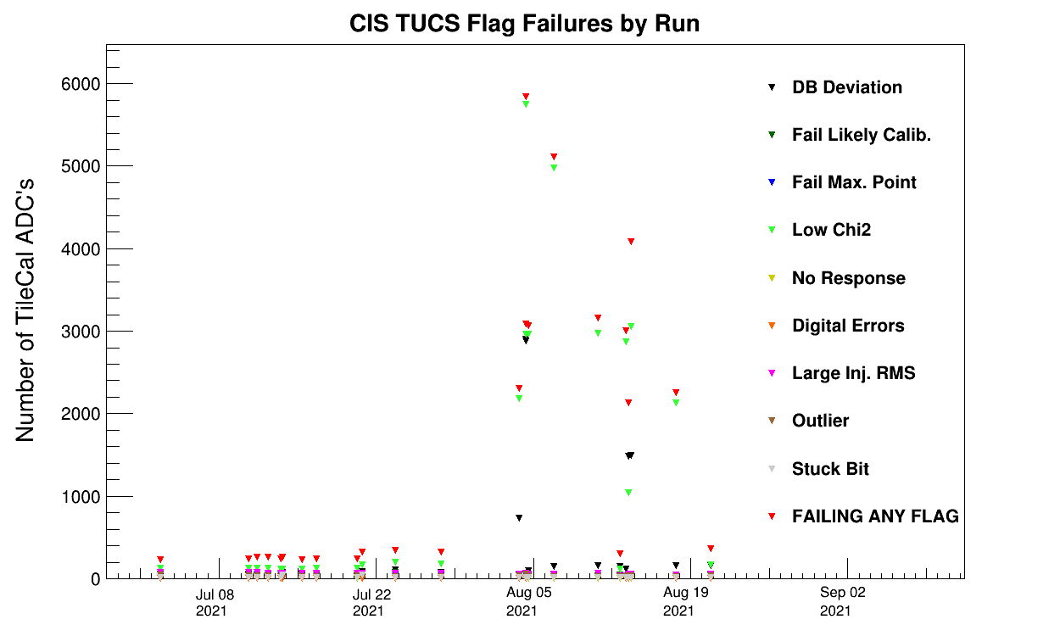
CIS TUCS Quality Flags

Slide 8
Removing Bad Runs

Slide 9
Runs Used by Partition and Gain
LBA_lowgain: 396441 397150 397165 397192 397291 397320 397455 397598 397763 397805 398035 398154 398681 398688 398766 398906 399044 399249 399289 399347 399539
LBA_highgain: 396441 397150 397165 397192 397291 397320 397455 397598 397763 397805 398035 398154 398681 398766 398906 399044 399249 399261 399289 399347 399539
LBC_lowgain: 396441 397150 397165 397192 397291 397320 397455 397598 397763 397805 398035 398154 398681 399044 399249 399539 399880
LBC_highgain: 396441 397150 397165 397192 397291 397320 397455 397598 397763 397805 398035 398154 398681 398766 398906 399044 399249 399539 399880
EBA_lowgain: 396441 397150 397165 397192 397291 397320 397455 397598 397763 397805 398035 398154 398681 398688 398766 399044 399249 399261 399289 399880
EBA_highgain: 396441 397150 397165 397192 397291 397320 397455 397598 397763 397805 398035 398154 398681 398766 398906 399044 399249 399261 399289 399347 399539 399880
EBC_lowgain: 396441 397150 397165 397192 397291 397320 397455 397598 397763 397805 398035 398154 398681 398688 398692 398766 398906 399044 399249 399261 399289 399347 399539 399880
EBC_highgain: 396441 397150 397165 397192 397291 397320 397455 397598 397763 397805 398035 398154 398681 398688 398692 398766 398906 399044 399249 399261 399289 399347 399539 399880

Slide 10
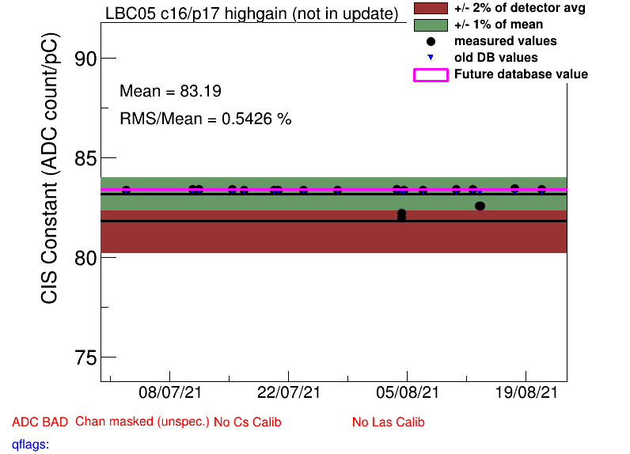
LBC Highgain: Before
Aug. 4:
398688: bad timing
398692: bad amp/charge ratio
Aug 13:
399261: bad timing
399289: bad timing
399347: bad timing

Slide 11
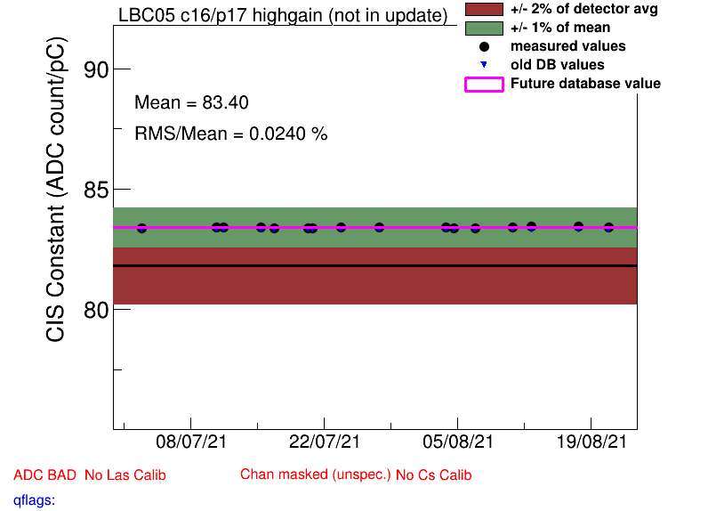
LBC Highgain: After

Slide 12
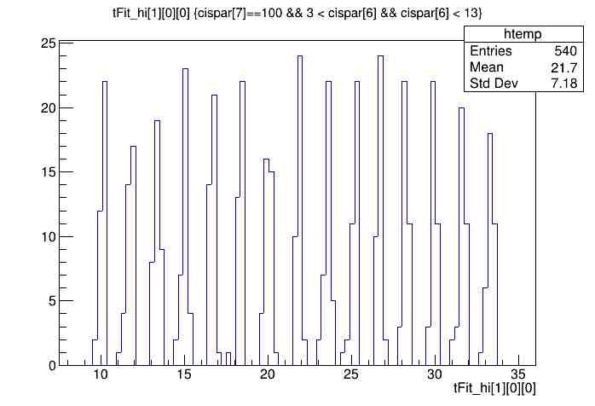
Bad timing plot (run 398688, LBC_highgain)
Shifted by ~25 ns
Good timings are in the range of (-15, 10) ns

Slide 13
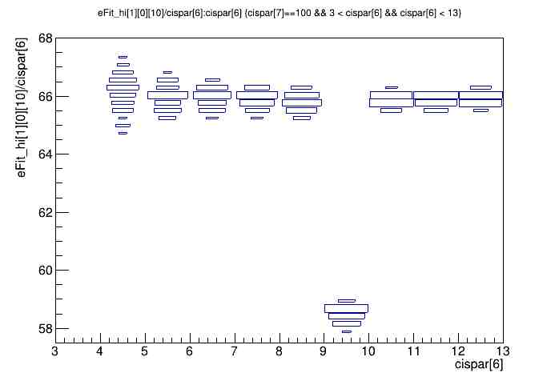
Bad Amp/Charge Plot (run 398692, LBC_highgain)

Slide 14
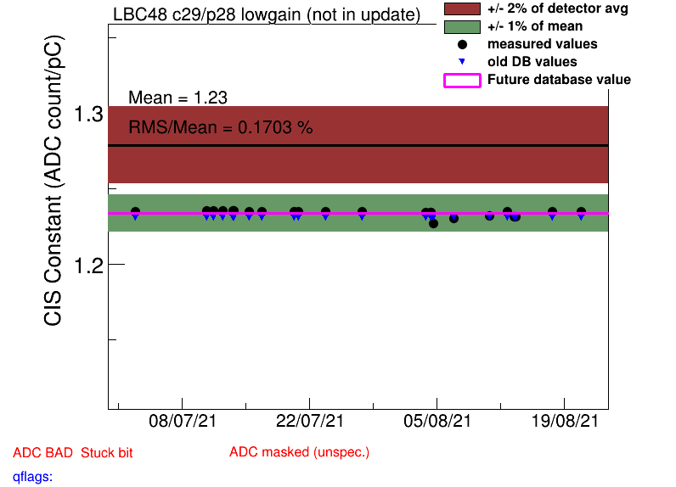
LBC Lowgain: Before

Slide 15
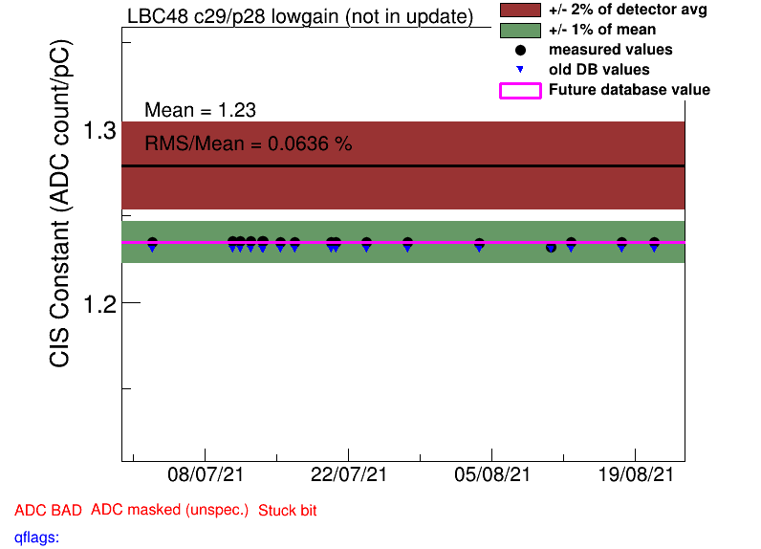
LBC Lowgain: After

Slide 16
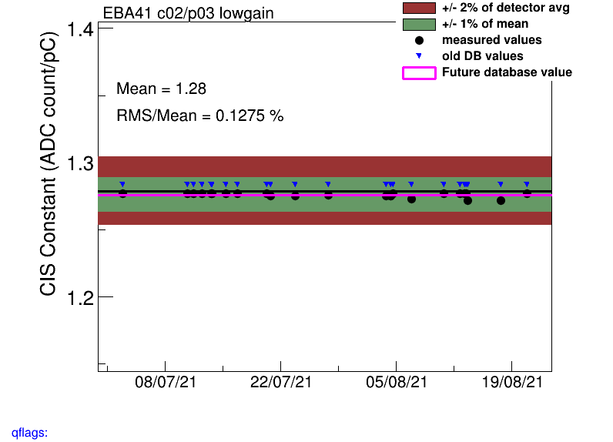
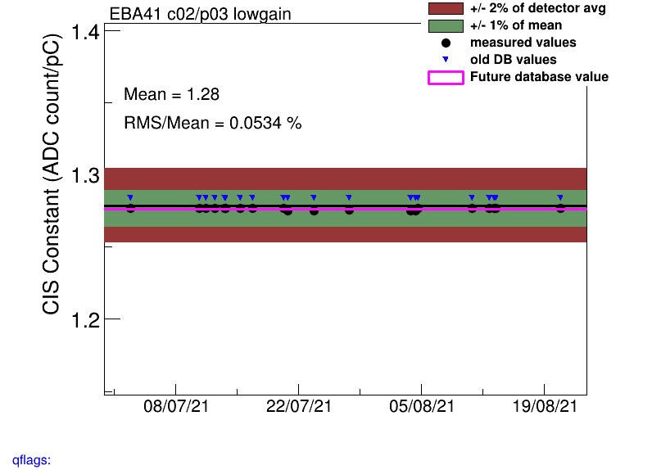
EBA lowgain
Bad runs
Run # : mm-dd
398688 : 08-04
398692 : 08-04
398906 : 08-06
399347 : 08-13
399539 : 08-17
After removing bad runs less scatter after 08-06
Recalibrated from 08-06

Slide 17
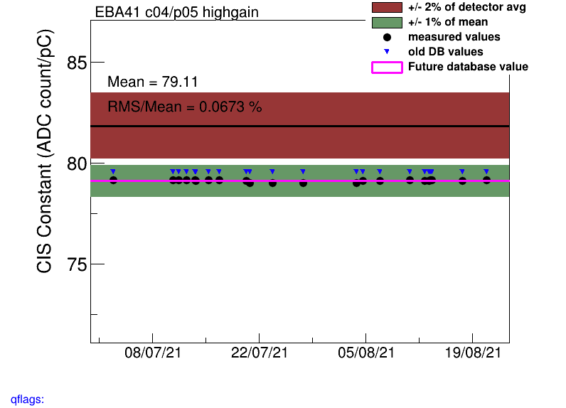

EBA Highgain
Bad runs
Recalibrated from 08-06
Run # : mm-dd
398688 : 08-04
398692 : 08-04

Slide 18
Interesting channel behaviour

Slide 19
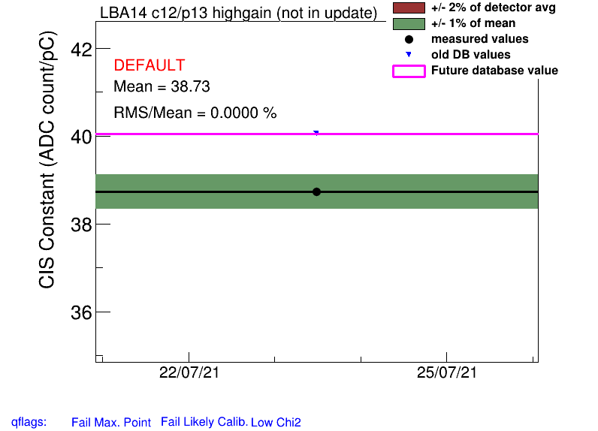
LBA_m14
All plots only contain 1 point, taken in late July
Highgain channels are all at half gain (we flagged them as BadCIS)

Slide 20
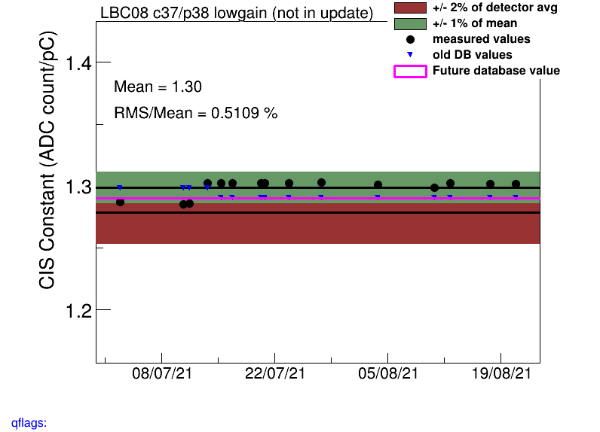
LBC_m08_c32-45_lowgain
Constant shift around 7/15
All were recalibrated after 7/15, and most flagged as bad CIS as they are not stable after this shift

Slide 21
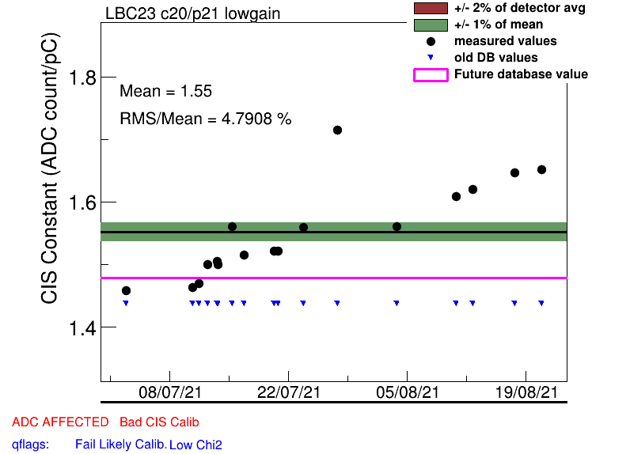
LBC_m23_c20_lowgain
High scatter with high deviation from detector average

Slide 22
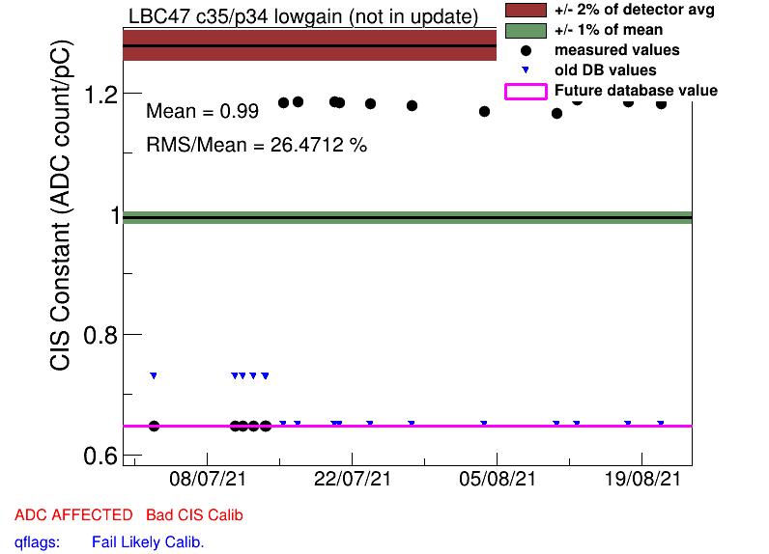
LBC_m47_c35_lowgain
Jumps from half gain
Still far from detector average and has high scatter in period after 7/15
Recalibrated after 7/15, remains flagged as BadCIS

Slide 23
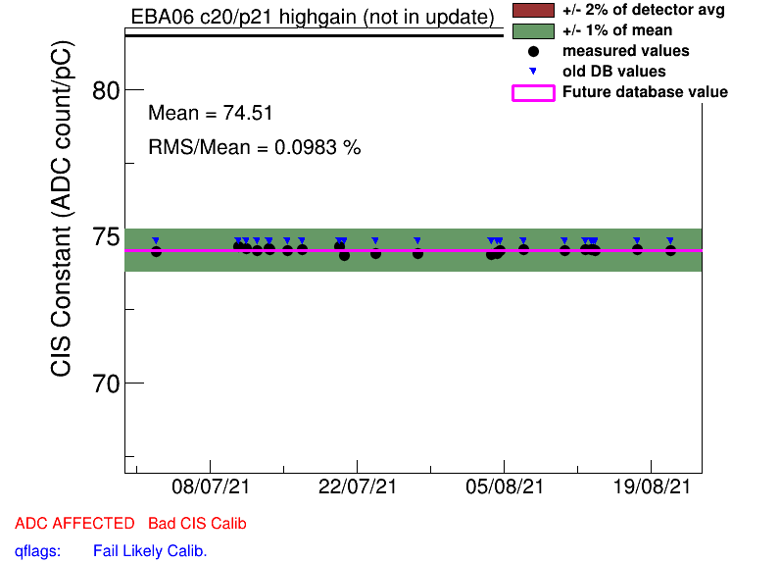
EBA_m06_c20_highgain
Too far away from detector average
Recalibrated from 08-06
Flagged Bad cis

Slide 24
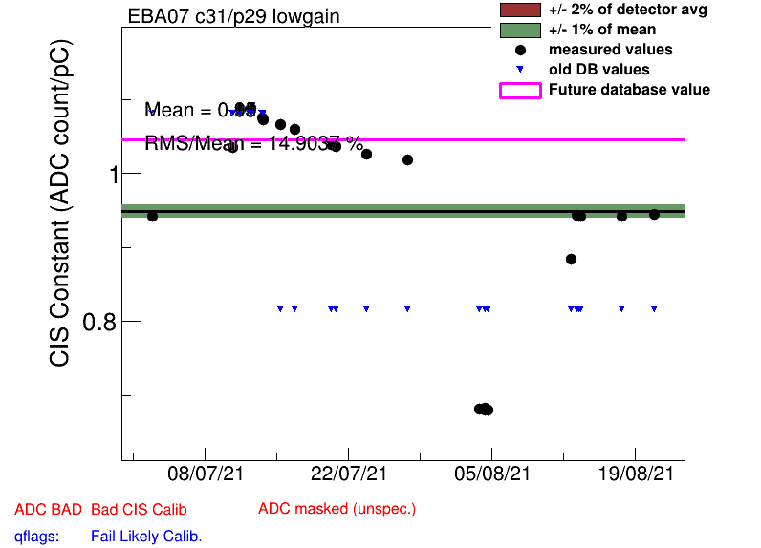
EBA_m07_c31_lowgain
Highly unstable before ~ 08-13
Too far from detector average after stabilizing
Flagged bad cis

Slide 25
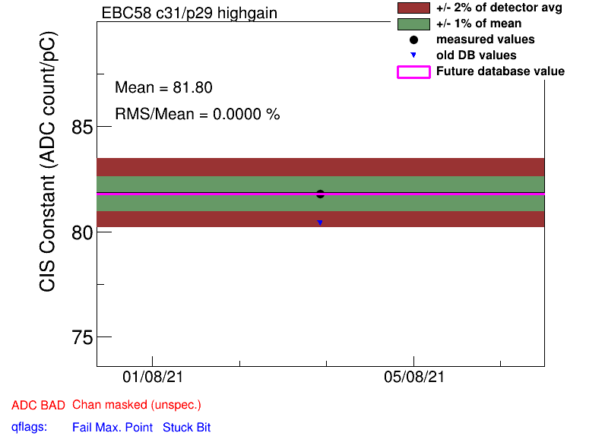
EBC_m58_c31_highgain
Only one run recorded between July and August
Flagged bad cis

Slide 26
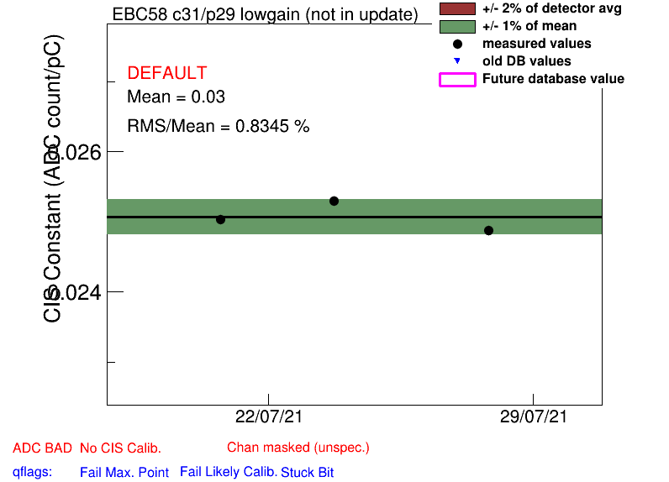
EBC_m58_c31_highgain
Flagged No CIS calib, Bad CIS
No data taken for channel in August
known problem?

Slide 27
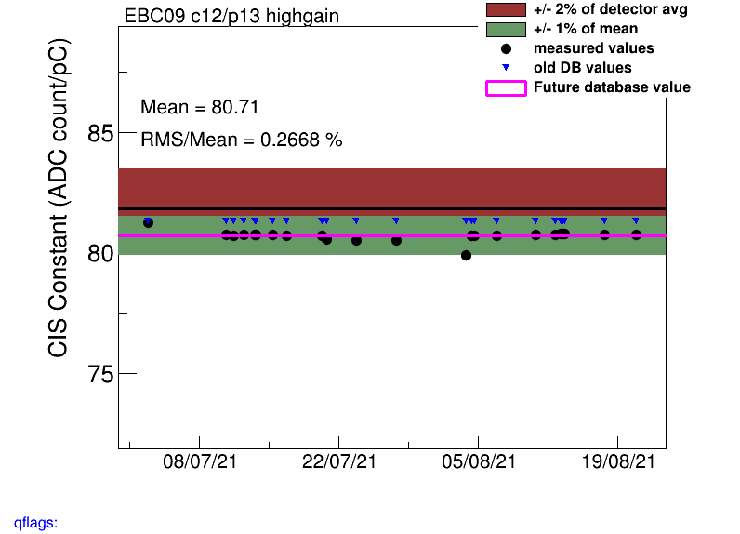
Constant Shifts
LBC_m08_c32-45_lowgain
LBA_m21_c32-35
LBA_m52_c01_lowgain
LBC_m20_c37_lowgain
LBC_m47_c35_lowgain
EBC_m09_c12_highgain

Slide 28
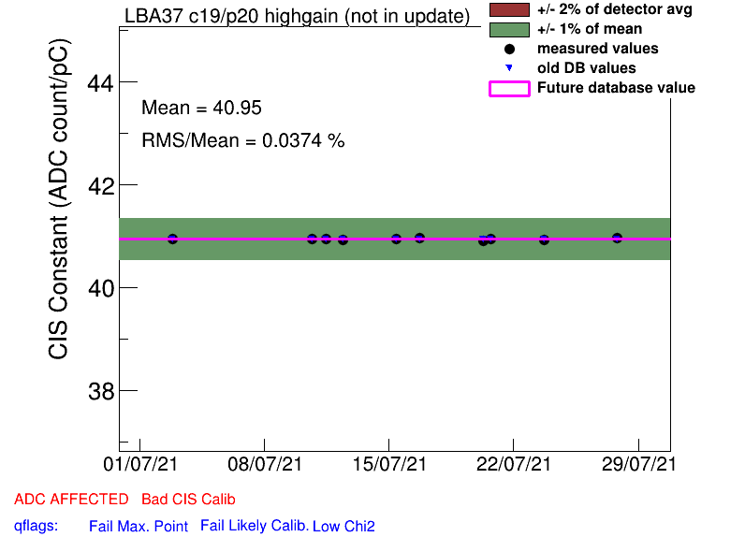
Half Gain Channels
EBA_m15_c08_highgain
EBA_m16_c00_highgain
EBA_m36_c15_highgain
EBA_m48_c31_lowgain
EBA_m64_c03_highgain
EBC_m09_c40_highgain
LBA_m37_c19_highgain
LBA_m14_highgain

Slide 29
COOL Flag Updates
Add BadCIS
EBA_m05_c10_highgain
EBA_m09_c16_highgain
EBA_m20_c31_highgain
EBA_m50_c20_highgain
EBC_m16_c07_lowgain
EBC_m57_c11_lowgain
EBC_m58_c31_highgain
LBA_m14_0-27,29,37,39,41,47_highgain
LBC_m08_c33_highgain
LBC_m08_c33-37,39-42,44_lowgain
LBC_m08_c41_lowgain
LBC_m19_c22_lowgain
LBC_m20_c37_lowgain
LBC_m28_c04_lowgain
LBC_m47_c35_lowgain
LBC_m52_c34_lowgain
Remove BadCIS
EBA_m05_c10_highgain
EBA_m12_c36_highgain
EBA_m48_c05_lowgain
LBA_m42_c07_highgain

Slide 30
Helpful links
Primary CIS tools (twiki)
Suspicious channels (this work)
Running a Monthly CIS Update (guide)
June 2021 Update

Slide 31
